Slide 1
HAND PUSH SEED SOWINGMACHINE
TEAM MEMBERS
1)Poornima
2)Ujwala
3)Shruthi
4)Srinivas
5)Sai

Slide 2
NEED STATEMENT
Now a days availability of labour is a major problem faced by farmers . The approach of the project is to create a machine which reduces their efforts and cost of seed sowing process with great efficiency and accuracy with reduce in labour requirement.

Slide 3
ABSTRACT
●We made seed sowing machine which is operated by hand to reduces the efforts of farmers .
●It increases the efficiency of plating also reduces the problem encountered in manual planting.
●For this machine we can plant different types and sizes of seeds .
i.e; maize , gram , peas , wheat , barley .
● We are also preparing this machine by raw materials thus it is so cheap and usable for small scale farmers.
●This machine can also increase the planting efficiency and accuracy.
●We simplified it’s design by the way for effective handling of the machine by any farmers or by any untrained workers .

Slide 4
INTRODUCTION
Seed sowing machine is a device which helps in the sowing of seeds in the desired position hence assisting the farmers in saving time and money.
We know that in manual seeding ,it is not possible to achieve uniformity in distribution of seeds.
In traditional methods seed sowing is done by broadcasting manually , opening furrows by a plough and dropping seeds by hand.
As the population of India continues to grow , the demand for produce of food also grows as well.
Hence , there is a greater need for multiple cropping in the farms and this , in turn , requires efficient and time-saving machines to plant the crops.

Slide 5
OBJECTIVE
The main objective of this project is to put the seeds in rows at desired depth .
It also has uniform seed to seed spacing.
During levelling it covers the seeds with soil and provide proper compaction over the seed.
Cost of this machine is low , because of using raw materials for construction .
Dependency on labour also decreased . Also it saves time of saving .

Slide 6
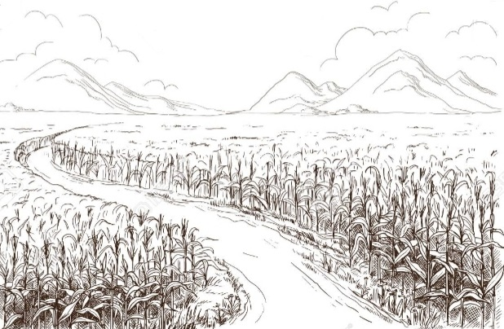
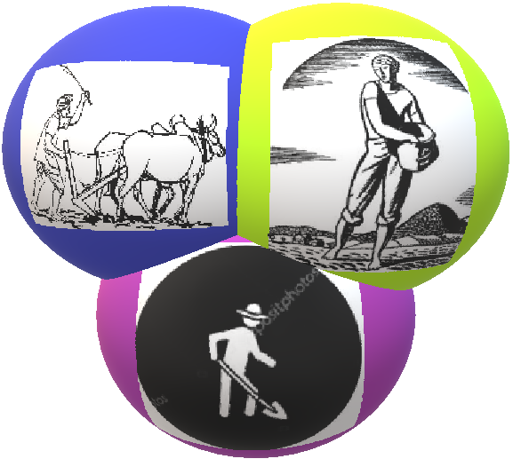
BENCHMARKS

Slide 7
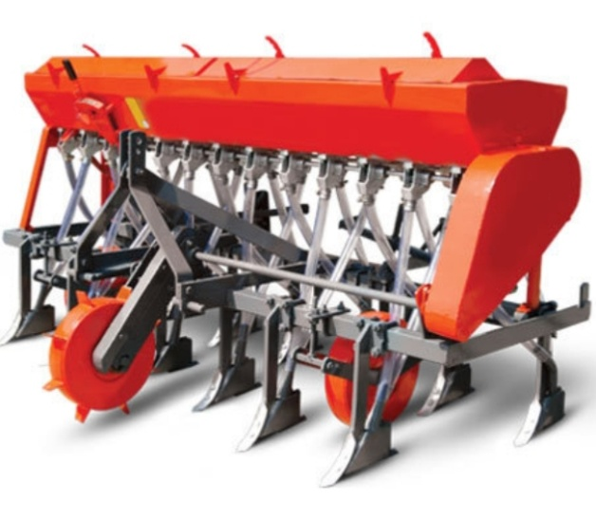
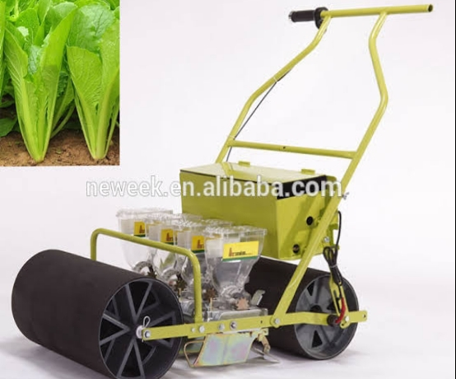
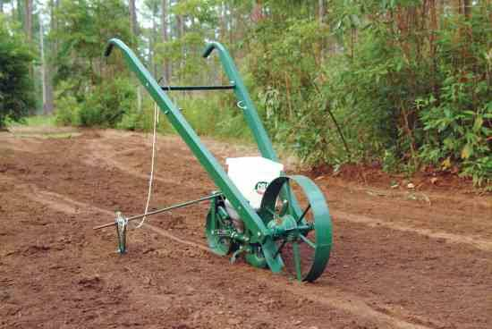
EXISTING SOLUTIONS

Slide 8
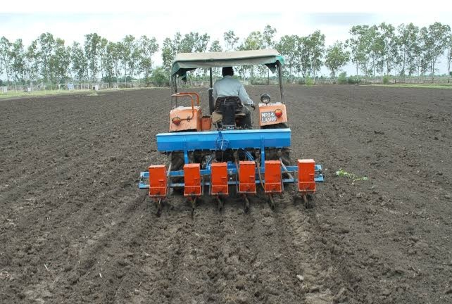
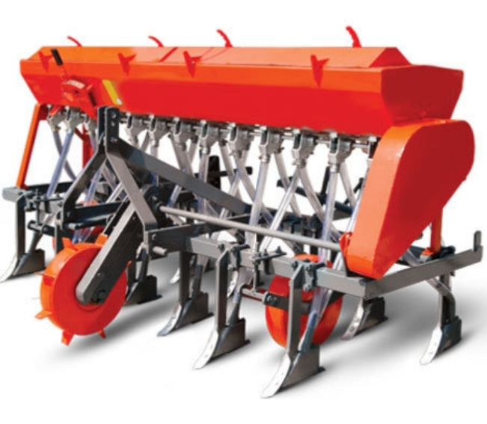
Demerits of first design:
●It is a huge machine , will be unable to carry.
●It’s cost is so high
●It should be used with help of tractor only , but the smoke releasing from tractor causes air pollution.

Slide 9
Demerits of second design:
●This machine is also heavy to carry.
●It’s cost is also high.
●It is worked by electric power
● If damages occurs to connections , the man who is operating gets shock.

Slide 10
Why we choose this design?
It is of less weight
It is to handle
It is of less cost
Even an illiterate farmer can operate this machine
It is easily sow lots of seeds
It does work simultaneously (i.e; ploughing , seed sowing and levelling)
No other sources are required for operating the machine

Slide 11
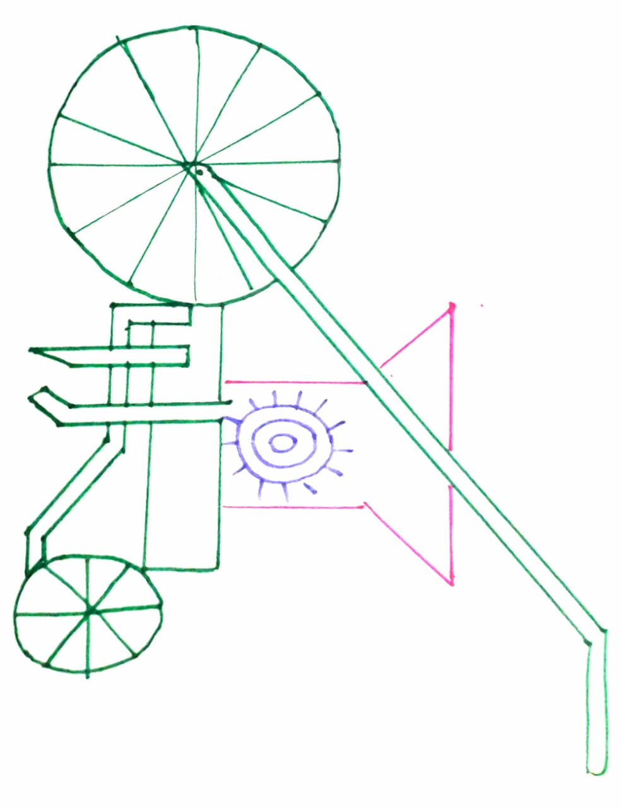
DESIGN OF THE PROTOTYPE:

Slide 12
Decision matrix:
 | LESS COST | LESS WEIGHT | PLOUGHING | SEED SOWING IN DESIRED POSITION | LEVELLING | LESS EFFORT FOR FARMER
LESS COST | _ | 4 | 2 | 2 | 3 | 1
LESS WEIGHT | 1 | _ | 2 | 2 | 3 | 2
PLOUGHING | 3 | 3 | _ | 1 | 2 | 1
SEED SOWING IN DESIRED POSITION | 3 | 3 | 4 | _ | 4 | 1
LEVELLING | 2 | 2 | 3 | 1 | _ | 1
LESS EFFORT FOR FARMER | 4 | 3 | 4 | 4 | 4 | _

Slide 13
CONCLUSION
I concluded that this seed sowing equipments we can save more time required for sowing.
And also it reduces lot of labour cost.
It is also very helpful for small scale farmers.
With the help of rollers the seed flow rate can be controlled and utilization of seeds by soil can be done in sequence manner with minimum lose.

